Slide 1
WAVELET TRANSFORM BASED
MULTI FOCUS IMAGE FUSION
PRESENTED BY,
PADMAPRIYA.S

Slide 2
DOMAIN
The wavelet transform is a mathematical technique that decomposes data into components at various scales, enabling detailed analysis of both time and frequency characteristics
Discrete Wavelet Transform (DWT) and the Stationary Wavelet Transform (SWT) are methodologies within the wavelet transform domain
The DWT has the ability to decompose images into sub-bands representing different frequency ranges where SWT is shift-invariant, meaning it does not suffer from the Down sampling process

Slide 3
PROBLEM STATEMENT
Single-modal constraints
Noise and artifacts
Limited sensor capability
Poor contrast
Redundant data storage

Slide 4
ABSTRACT
Before the development of image fusion techniques, challenges such as incomplete information, difficulty in interpretation, and loss of critical data led to inaccurate results.
Inconsistent image quality was also a significant problem.
Advancements in the Discrete Wavelet Transform (DWT) combined with the Stationary Wavelet Transform (SWT) algorithm have provided enhanced translational invariance.

Slide 5
INTRODUCTION
A wavelet transform is a mathematical technique that breaks down a signal into a collection of basis functions
Multi focus is applicable for image restoration from degraded, image mixing and face morphing
Various fields like medical imaging, remote sensing, Surveillance and Security can be deployed
The resulting image can be more explanatory than the individual images and is useful for both humans and machines

Slide 6
Multi-focus image fusion (MIF) is a technique that combines multiple images of the same scene with different focus areas to create a single image with total focus

Slide 7
LITERATURE SURVEY
S.NO | Title | Author | Year Published | Drawbacks
1 | Deep Ensemble Learning based model for disease monitoring and prediction | Periyasamy, Jayalakshmi | 2023 | Noisy Images
2 | Multi focus Image Fusion based on DWT with CNN | S.Mukhil Varma | 2022 | Can’t Reaches the satisfactory Decision map
3 | Injected Infrared Via Decomposition model and Guided Filtering | Yanhzhang | 2022 | Poor Visibility

Slide 8
S.NO | Title | Author | Year Published | Drawbacks
4 | Infrared and Visible Image Fusion Network based on DWT | Yanzhi Wang | 2021 | Low Frequency light image fusion
5 | Multi-Focus Image Fusion based on Neighbor Distance | H Zhao,Z Shang | 2020 | Lowpass Image

Slide 9
PROPOSED SYSTEM
DWT efficiently handles both frequency and spatial information. SWT handle the translation-invariant and preserves edge information better, making it suitable for detailed feature extraction.
Combination of Discrete Wavelet Transform (DWT) and Stationary Wavelet Transform (SWT) in Multi focus image fusion can offer a robust approach to retain relevant details from multiple input images.
The combination leverages the strengths of both transforms for better fusion results

Slide 10
SYSTEM ARCHITECTURE
Low Resolution Image
SWT
DWT
LL
LH
HL
HH
HL
HH
LL
LH
+
+
+
Estimated HL
IDWT
High Resolution Image

Slide 11
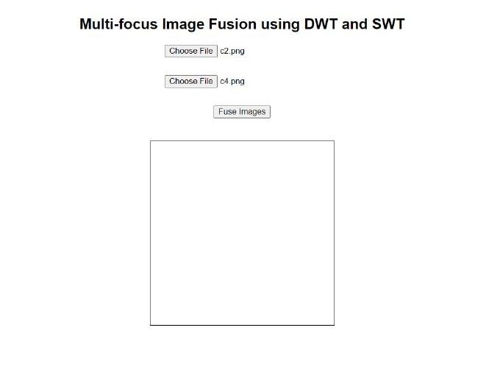
RESULT

Slide 12
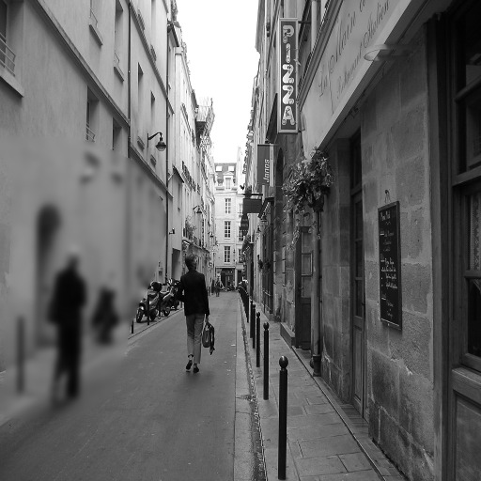

c2.png c4.png

Slide 13
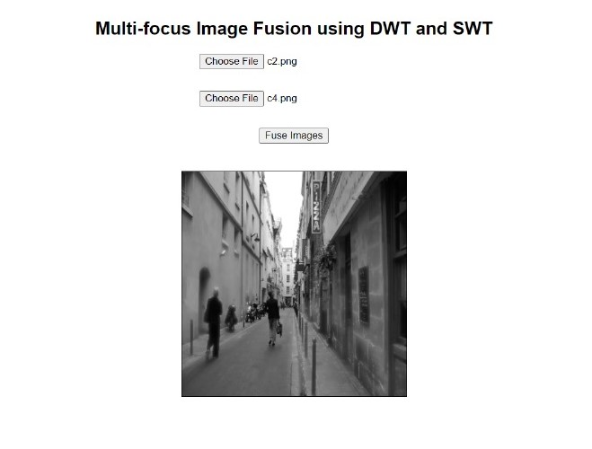

Slide 14
CONCLUSION
Combining DWT and SWT enhances multi-focus image fusion by preserving fine details and sharpness, resulting in clearer and more detailed fused images
The hybrid approach outperforms traditional methods in terms of both visual quality and evaluation metrics like PSNR and SSIM, making it highly effective for applications requiring detailed image clarity

Slide 15
REFERENCE
“Multi-Focus Image Fusion Using an Effective Discrete Wavelet Transform Based Algorithm”-Yong Yang, Shuying Huang. (2024)
“Multi-focus image fusion with a deep convolutional neural network”-Liu, Y., Chen, X., Peng, H., & Wang, Z. (2023)
“A Critical Analysis of the Multi-Focus Image Fusion Using Discrete Wavelet Transform and Computer Vision”- GB Gebremeskel. (2022)

Slide 16
“Multi-focus Image Fusion using Neutrosophic based Wavelet Transform”- Shiveta Bhat, Deepika Koundal. (2021)
“Stationary Wavelet Transform Based Image Fusion Using Fusion Rules”- Nainavarapu Radha. (2020)

Slide 17
THANK YOU!

